Slide 1

MCS THESIS PRESENTATION
Comparative Benchmarking of CatBoost, TabPFN and TabFM for Explainable Hair Fall Risk Stratification
CatBoost
tuned decision trees
Krishna Gautam
TabPFN
pre-trained transformer
Supervised by Rabin Thapa
TabFM
Lincoln International College of Management & IT
Lincoln University College, Malaysia · September 2026
Google foundation model
Notes:
Good morning. My thesis compares a classical tuned model, CatBoost, with two new pre-trained 'foundation' models, TabPFN and TabFM, for predicting hair fall risk, and it also explains what each model relies on.

Slide 2
What we will cover
1
Introduction
2
Method
3
Results
Why hair fall risk is hard, the gaps, our questions
The three models, the data, a fair test
Accuracy, training size, significance, errors
Slides 3–6
Slides 7–10
Slides 11–15
4
Explainability
5
Cost and discussion
6
Conclusion
What drives the risk (SHAP)
Run time, model choice, limits
Answers and recommendations
Slides 16–17
Slides 18–20
Slides 21–22
2
Notes:
Here is the roadmap: why the problem matters, how the study was designed, what we found, how the models can be explained, what it costs, and what we conclude.

Slide 3



Hair fall risk is hard to judge by eye
Many causes act together
21,606
Iron, protein, vitamin D, liver function, stress, sleep, chemicals and family history all play a part.
patients in the dataset
No single test tells the risk
20
Risk comes from the mix of factors, so one measurement alone is not reliable.
clinical and lifestyle features
Today: history and late examination
3
Assessment depends on what patients report, differs between doctors and is hard to reach in many places.
risk tiers: Low · Moderate · High
3
Notes:
Hair loss has many causes at once. No single blood test gives the answer, and today the assessment depends on what the patient says and on a late clinical check. A tool that combines many measurements could give an earlier, more objective estimate.

Slide 4



Three gaps in earlier work made this study necessary
No clear best model
New models, never tested here
Black boxes
One study found an ensemble best, another found Random Forest ahead of CatBoost. Data and goals differ, so the results cannot be compared.
TabPFN and TabFM predict from the training rows without being trained, but nobody had tried them on hair fall data.
Accurate models rarely say why. Without reasons, a doctor cannot check a risk score against clinical knowledge.
Our answer: compare CatBoost, TabPFN and TabFM on the same data, at three training sizes, and explain all three with SHAP.
4
Notes:
First, earlier studies disagree about which model is best. Second, the new foundation models had never been tested on hair fall data. Third, complex models do not explain themselves. Our study addresses all three at once.

Slide 5
What we wanted to find out: four questions
Can pre-trained models match a tuned CatBoost, and is the difference real?
How we tested it
Q1
Same split and metrics, plus McNemar's test
How much training data does each model need?
How we tested it
Q2
Every model at 500, 2,000 and 17,284 rows
Which features drive the risk, and do the models agree?
How we tested it
Q3
SHAP for every model and every size
What does each model cost to run?
How we tested it
Q4
Record run time, memory and problems
5
Notes:
Each research question has one matching objective and one part of the method. We will come back to these four questions in the conclusion.

Slide 6
Earlier studies were useful, but they disagree
Study | What they found
Widowati et al. [1] | Explainable system; keep data preparation inside cross-validation
Sai et al. [3] | An ensemble beat single classifiers
Patel et al. [4] | Random Forest beat XGBoost, CatBoost and LightGBM
Chen et al. [5] | Neural networks find more, but are harder to explain
Shakeel et al. [6] | Scalp images: SVM 91.4%, KNN 88.9%
The gap
Conflicting answers on the best model
Foundation models untested on hair fall data
Explainability treated unevenly
6
Notes:
These are the main hair loss studies. They used different data and targets, so their accuracy numbers cannot be compared with ours. The important point is that none of them tested foundation models, and only one was built to be explainable.

Slide 7
Three models, three ways of learning
CatBoost
TabPFN
TabFM
Learns from the data
Pre-trained, no training
Google's foundation model
Many small decision trees, each fixing the last one's mistakes
Tuned by grid search and 5-fold cross-validation
Trains in seconds, small model
Transformer trained on millions of synthetic tables
Reads our training rows as examples and predicts in one pass
Needs the rows at prediction time
Same idea, with attention over rows and columns
About 6.5 GB of weights, the slowest of the three
Needs a GPU for full-size data
Foundation model = a model that has already learned how tables work, so it needs no training on our data.
7
Notes:
CatBoost really trains on our rows and is tuned by cross-validation. TabPFN and TabFM are pre-trained on millions of synthetic tables, so for our data they only read the training rows as examples. This is why they need little data but are slower at prediction time.

Slide 8
The data: 21,606 patients, 20 features, 3 risk tiers
Blood markers
iron, protein, calcium, vitamin D, liver enzyme ALT, manganese, body water
Stress and hair scores
stress level, hair texture, keratine
Lifestyle and history
sleep, chemicals, water, anemia, illness, family history
Basics
age and gender
Company dataset: a benchmark, not a clinical trial.
8
Notes:
The data come from a company dataset, so this is a benchmark of models, not a clinical trial. There are no missing values, no duplicates and no impossible values.

Slide 9








The study in one picture
1
2
3
4
Data
Clean data
Split once
Three sizes
Company dataset, 21,606 records
reference ranges; drop names and id
80% train (17,284), 20% test (4,322)
500 · 2,000 · Full training rows
5
6
7
8
Three models
Same test set
Explain
Compare
CatBoost, TabPFN, TabFM
accuracy, F1, AUC, kappa
SHAP for all nine runs
McNemar, run time, scaling
Each stage is one step in our own Hairfall Lab; the final runs were executed on a Kaggle Tesla T4 GPU.
9
Notes:
Everything is a numbered step. We check and clean the data, split it once, give each model three training sizes, test all of them on the same 4,322 patients, explain them with SHAP, and finally compare and test the differences. The final runs were done on a Kaggle T4 GPU.

Slide 10
Six rules that keep the comparison fair
1
Same split
2
Same test patients
3
Three training sizes
17,284 training and 4,322 test records; fixed seed 42
Every model is scored on all 4,322; never used for tuning
500, 2,000 and 17,284 rows for every model
4
Fair baseline
5
Many measures
6
Real tests
CatBoost tuned: 9 settings x 5-fold cross-validation
Accuracy, macro-F1, ROC-AUC, kappa, log loss
McNemar's test and 95% confidence intervals; SHAP for all
10
Notes:
These rules mean any difference we see comes from the models and the amount of data, not from unfair treatment. CatBoost was tuned properly so that the baseline was not handicapped, and the test patients were never used for tuning or stopping.

Slide 11
With all the data, the three models are almost equal (78.2% to 78.7%)
Full training data
78.67%
TabFM · macro-F1 0.780
78.62%
TabPFN · macro-F1 0.778
78.20%
CatBoost · macro-F1 0.774
Gap between best and worst: 0.47 points.
11
Notes:
This chart shows the accuracy of all nine runs. With 500 or 2,000 rows the two foundation models are clearly ahead of CatBoost. With all 17,284 rows the three models are within half a percentage point of each other. Note that the vertical axis starts at 60 percent so that the differences are visible.

Slide 12
CatBoost needs lots of data; the foundation models do not
Gain from 500 rows to all rows
+8.83
CatBoost
acc. points
+1.73
TabPFN
acc. points
+1.83
TabFM
acc. points
500 rows of a foundation model beat CatBoost with 2,000 rows.
12
Notes:
CatBoost gains almost nine accuracy points when it gets all the data, while the foundation models gain less than two. With only 500 rows the foundation models are already better than CatBoost trained on 2,000 rows. The same behaviour in two independently built models suggests it is a property of this kind of model, though we tested only one dataset.

Slide 13
Is the gap real? Yes with little data, no with all the data
Rows | Comparison | b | c | p-value | Real gap?
500 | CatBoost vs TabPFN | 272 | 597 | < 0.0001 | Yes
500 | CatBoost vs TabFM | 280 | 603 | < 0.0001 | Yes
500 | TabPFN vs TabFM | 71 | 69 | 0.93 | No
2,000 | CatBoost vs TabPFN | 194 | 337 | < 0.0001 | Yes
2,000 | CatBoost vs TabFM | 196 | 346 | < 0.0001 | Yes
2,000 | TabPFN vs TabFM | 60 | 67 | 0.59 | No
Full | CatBoost vs TabPFN | 111 | 129 | 0.27 | No
Full | CatBoost vs TabFM | 114 | 134 | 0.23 | No
Full | TabPFN vs TabFM | 33 | 35 | 0.90 | No
What it means
500 and 2,000 rows: both foundation models beat CatBoost (p < 0.0001)
All rows: no significant difference (p = 0.27 and 0.23)
TabPFN and TabFM: never different
b = only first model right, c = only second model right
13
Notes:
McNemar's test looks only at patients where two models disagree. With 500 and 2,000 rows both foundation models are significantly better than CatBoost, with p below 0.0001. With all the data there is no significant difference. TabPFN and TabFM never differ from each other. A non-significant result does not prove the models are equal, only that no difference was detected.

Slide 14
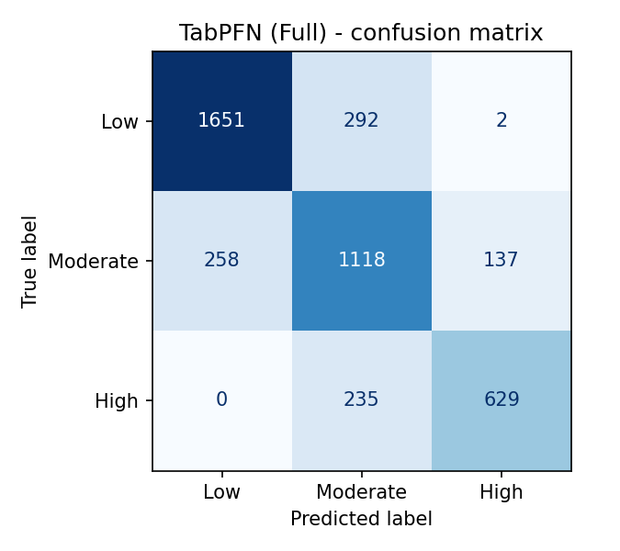
When models are wrong, they miss by one tier only
922 of 924
errors are between neighbouring tiers
2 and 0
Low called High, and High called Low
0.71
F1 of the Moderate tier: the hardest to classify
TabPFN, full training data
All three models show the same pattern.
14
Notes:
The confusion matrix shows true tiers as rows and predicted tiers as columns. Almost all mistakes are between neighbouring tiers. Calling a Low patient High happened only twice and calling a High patient Low never happened. The Moderate tier is the hardest because it sits between the other two.

Slide 15

Three more checks: probabilities, shared mistakes, fairness
Better probabilities
Shared mistakes
No big group gaps
0.66 to 0.50
793 patients
≤ 2 points
log loss with 500 rows: CatBoost vs TabPFN (lower is better). The gap shrinks with more data: 0.49 vs 0.47.
wrong for all three models with full data (18%); that is 84 to 86% of each model's errors. The limit is in the data.
largest accuracy gap between women and men (1.1) and between age bands (2.0), with full data.
15
Notes:
First, the probabilities of the foundation models are better, especially with little data. Second, the three models make mostly the same mistakes, so the limit is in the data and not in the model. Third, accuracy is similar for women and men and for the age bands, so no group is served much worse.

Slide 16
SHAP: iron and stress lead every model
What is SHAP?
A score for how much each feature pushed a patient's risk up or down.
Iron and stress level: top two in all 9 analyses
Then protein, liver enzyme ALT, vitamin D, calcium
Same six lead in 8 of 9 analyses
Rank agreement between models: 0.90 to 0.96
16
Notes:
SHAP gives each feature a score for how much it pushed each patient's prediction up or down. In all nine analyses, iron and stress level were the top two features, followed by protein, the liver enzyme ALT, vitamin D and calcium. The rankings of the three models agree closely.

Slide 17
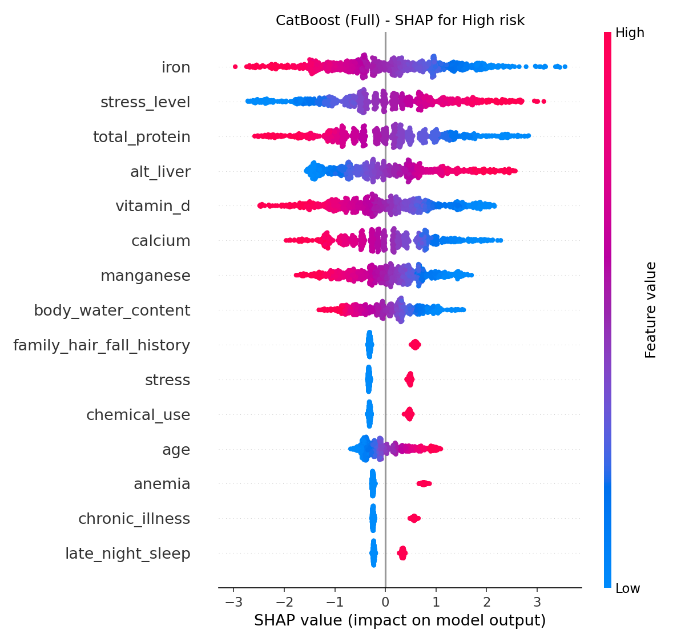
The direction of the effects makes clinical sense
How to read the plot
Each dot is a patient. Right of the centre = pushes towards High risk. Red = high value, blue = low value.
Low iron, high stress and high liver enzyme raise the risk
High protein, vitamin D, calcium and manganese lower it
Every yes/no risk factor pushes risk up
Same directions in CatBoost, TabPFN and TabFM
Matches the data: stress 0.33, iron -0.31, protein -0.30 (correlation with risk tier). Association, not cause.
17
Notes:
In the plot, each dot is one patient. Dots to the right push the prediction towards High risk, and the colour shows whether the patient's value is high or low. Low iron and high stress push risk up, while higher protein, vitamin D and calcium push it down. This agrees with the simple correlations in the data. It shows what the models learned from this company dataset, not proof of cause.

Slide 18
The price: foundation models are slow to run and to explain
CatBoost (full data)
TabPFN (full data)
TabFM (full data)
3.3 s
≈ 5 min
≈ 51 min
fit and predict
290 s to predict 4,322 patients
3,082 s to predict 4,322 patients
Explaining costs even more
Problems we had to solve
CatBoost SHAP: 1,000 patients in 0.3 s
TabPFN SHAP: 30 patients in 54 min
TabFM SHAP: 20 patients in 2.4 hours
TabFM full size ran out of memory on a 16 GB laptop, so it needed a GPU
Memory-saving attention and automatic batch halving
Package conflicts and single-row failures
18
Notes:
With the full data, CatBoost is fitted in about three seconds. TabPFN needs about five minutes and TabFM about fifty minutes to predict the test patients on a T4 GPU. Explaining them with Kernel SHAP is even slower. TabFM full-size could not run at all on our 16 GB laptop without a GPU, so we used Kaggle with memory-saving settings.

Slide 19
What it means: which model should you choose?
Situation | Choose | Why
Only a few thousand labelled rows (or fewer) | TabPFN or TabFM | 7 to 8 points more accurate at 500 rows; better probabilities; no tuning
A lot of data, and a tool that scores one patient at a time | CatBoost | Same accuracy with all rows, trains in seconds, small model, no GPU
You need a reason for every score | Any, with SHAP | All three can be explained; CatBoost is exact and 0.3 s
You need fast, cheap deployment | CatBoost | Foundation models need the training rows and a GPU at prediction time
Caution: measured on one company dataset.
19
Notes:
The choice depends on how much labelled data you have and where the model will run. With few rows a foundation model is much better and gives better probabilities. With plenty of data CatBoost is just as accurate, thousands of times cheaper, and works on a normal computer for one patient at a time. Explanations are possible for all, cheapest for CatBoost.

Slide 20
What to keep in mind: the limits of this study
Company data
One split, one seed
Small SHAP samples
One company dataset, not a clinical registry. Results are not a diagnostic tool.
Small differences at full size cannot be separated from chance.
30 and 20 patients for the foundation models; only leading features are interpreted.
Hardware and versions
Grid and settings
Not tested
CatBoost on CPU, others on GPU; TabPFN and SHAP versions were not fixed.
Small CatBoost grid; foundation models used default settings.
Ordinal models, patient-level explanations and real clinical data.
20
Notes:
We want to be open about the limits. The dataset comes from one company, so the results are about the models and not about real patients. We used one split and one seed. SHAP for the foundation models used only 30 and 20 patients. Timings come from different hardware for CatBoost and the foundation models.

Slide 21
Conclusions: answers to our four questions
Performance
With all the data no significant difference (78.2% to 78.7%); with 500 and 2,000 rows the foundation models win (p < 0.0001).
Q1
Training size
CatBoost gains 8.8 points from 500 rows to all; TabPFN and TabFM gain 1.7 and 1.8.
Q2
Explanation
Iron and stress level lead in all 9 analyses; effects point the same way and match the data.
Q3
Cost
CatBoost: seconds. TabPFN: about 5 minutes. TabFM: about 51 minutes on a GPU, and it needs one.
Q4
21
Notes:
These are the four answers. One: no significant difference with all the data, but foundation models are clearly better with little data. Two: CatBoost depends much more on data. Three: iron and stress lead in every model and the directions agree. Four: CatBoost costs seconds, TabPFN minutes and TabFM close to an hour on a GPU.

Slide 22
Recommendations and what comes next
For practice
For further research
Few labelled rows: start with TabPFN
Plenty of data: a tuned CatBoost is enough
Measure run time and memory before you plan
Always add SHAP; use it as decision support only
Several splits and seeds, with confidence intervals
Explain more patients; add patient-level plots
Tune all models; try ordinal models
Validate on real clinical data
Ensembles and lighter, distilled models
Thank you · Questions?
22
Notes:
For practice: use a foundation model when data are few, use CatBoost when data are plentiful, check cost before choosing, and always add explanations. For research: repeat with several splits, explain more patients, tune all models, try ordinal models, validate on real clinical data, and study ensembles. Thank you, I am happy to take your questions.

